Slide 1
Capital Budgeting
Net Present Value
Internal Rate of Return
Profitability Index
Payback Period
Internet Credits for PMTycoon for the slides, modified for lecture purpose by Dr. Dilrukshi Gamage

Slide 2
Capital budgeting Techniques
Investment decisions are generally called capital budgeting decisions
How do you decide - whether you should invest in Project A or Project B ?
Criteria
NPV 🡪 What is the value of the return on investment.
IRR 🡪 % of Return on investment.
Profitability Index 🡪 Profit ratio for every dollar spent.
Payback period 🡪 Time to recover your investments, A Break even point.

Slide 3
Opportunity cost
Invest in a Bank - Bank Annual Returns: 8%
Invest in a Project - Project Annual Returns : 10%
What is the opportunity cost if you invest in the Bank?
What is the opportunity cost if you invest in the Project?
So, where should you invest your money?
‹#›

Slide 4
Cash Flows
Discounted Cash Flow
2. Non Discounted Cash Flow
‹#›

Slide 5
Discounted cash flow
Discounted Cash flow is nothing but the Opportunity Cost.
Rate of return that an organization could have earned on the investment, if not invested in the current project.
In other words, it’s the rate of return that an organization is willing to loose in an expectation to earn more by investing in this project.
It is the lost opportunity on the capital that is being invested in the projects.
Other names for Discounted cash flow
Opportunity Cost of Capital
Cost of Capital
‹#›

Slide 6
Discounted cash flow
Let’s say If an organization earns 10% interest per annum on its capital by putting the money in bank instead of investing in the project.
What is the opportunity cost of the capital ?
10% - You are correct.
Since it is the minimum that an organization could have earned if invested the money in the bank.
‹#›

Slide 7
Non Discounted cash flow
In Non discounted cash flow, the interest rate, opportunity cost or Discounted cash flow is not taken in to consideration.
‹#›

Slide 8
Consideration for Capital budgeting
Discounted
Cash Flow
NPV - Net present Value
IRR - Internal Rate of Return
PI – Profitability Index
Discounted
Cash flow
Non-Discounted Cash flow
Payback period (Payback period is usually calculated considering the Non discounted cash flow.
Non-Discounted Cash flow
‹#›

Slide 9
Time Value of Money
A Dollar sitting in your wallet is worth more today than the same dollar tomorrow.
Can you tell Why?
Depreciation.
Money grows over time when it earns interest.
So, the time value of money brings us to the concept of
Future Value of Money.
Present Value of Money.
‹#›

Slide 10
Relationship between FV & PV
Future Value of Money (let’s call it FV)
Present Value of Money (let’s call it PV)
FV = PV (1 + K)^{n}
FV = Future Value
PV = Present Value
K = Discounted Rate in %
n = Number of Years
‹#›

Slide 11
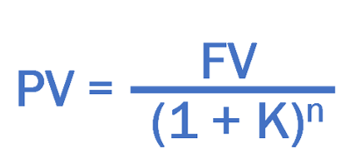
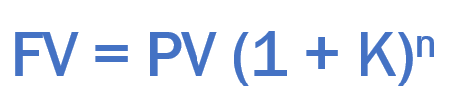
Relationship between FV & PV
‹#›

Slide 12
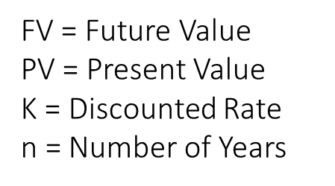
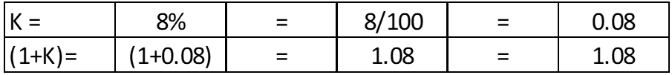
Calculate the Future Value
Example: If $ 100 dollars is invested in a bank today may earn 8% per year.
what is the future value of the $ 100 dollars for 1st, 5th and 15th year?
FV = PV (1 + k)^{n}
PV = 100
n = 1
n = 5
n = 15
K = 8%
FV = ? When n =1, n=5, n=15
After 1 year(n=1): FV = 100 X (1.08)¹ = 100*1.08 = $108
After 5 years (n=5): FV = 100 X (1.08)⁵ = 100*1.08*1.08*1.08*1.08*1.08 = $146.93
After 15 years (n=15): FV = 100 X (1.08)¹⁵ = $317.22
‹#›

Slide 13
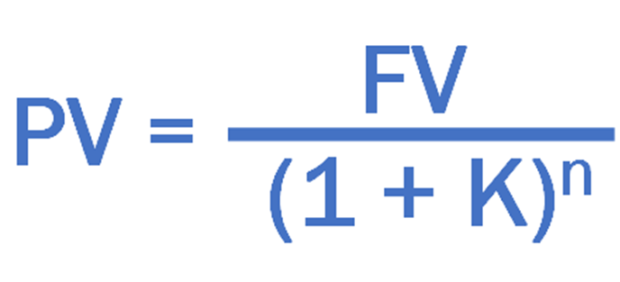
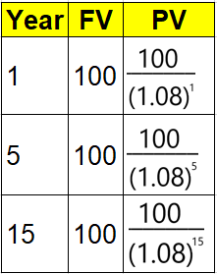
Calculate the Present Value
Example
If $ 100 dollars is to be received after 1 year, what is the present value of $100 dollars today?
If $ 100 dollars is to be received after 5 years, what is the present value of $100 dollars today?
If $ 100 dollars is to be received after 15 years, what is the present value of $100 dollars today?
Note: Discounted rate is 8% per year.
FV = 100
n = 1
n = 5
n = 15
K = 8%
PV = ? for n =1, n=5, n=15
The Present value of $ 100 to be received after 1 year is $93 dollars today.
The Present value of $ 100 to be received after 5 years is $68 dollars today.
The Present value of $ 100 to be received after 15 year is $32 dollars today.
‹#›

Slide 14
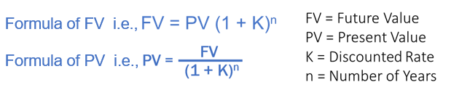
A quick recap so far…
So far we learned about
Dicounted Cash flow (Opportunity cost)
Non Discounted Cash flow
Future Value
Present Value
‹#›

Slide 15
Let’s now do the calculations
Capital Budgeting
Net Present Value
Internal Rate of Return
Profitability Index
Payback Period

Slide 16
Net Present Value
Capital Budgeting
Net Present Value
Internal Rate of Return
Profitability Index
Payback Period

Slide 17
Net Present Value
Net Present Value (NPV) = “Present Value of all cash inflows – Present Value of all cash outflow”
Example: Salary Slip
Net Salary = Gross Salary – Deductions
Similarly, The Present Value of all cash inflows is the Gross Present Value
and if you deduct cash outflows it becomes your Net Present Value.

Slide 18
Net Present Value
Criteria
If NPV > 0 (NPV is +ve, Accept the Project)
If NPV < 0 (NPV is –ve, Reject the Project)
If NPV = 0 (Accept the Project, considering other non tangible benefits)
Greater the NPV, Better the Prospects

Slide 19

Example1: Calculating NPV
A sum of $ 400,000 dollars invested today in an IT project may give a series of below cash inflows in future:
$ 70,000 in year 1
$ 120,000 in year 2
$ 140,000 in year 3
$ 140,000 in year 4
$ 40,000 in year 5
If Opportunity cost of capital is 8% per annum, then should we accept or reject the project?
Solution:
Step 1: Calculate the PV value of year 1, year2, year3, year4, and year5
Step 2: Sum up the PV of all years
Step3: NPV = Present value of all cash inflows – Present value of all cash outflow.
Step 4: If NPV is positive, Accept the project, if not Reject the project.

Slide 20

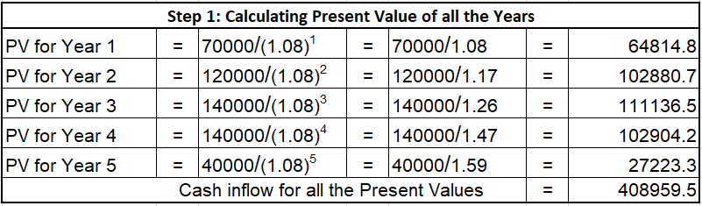
Cash Inflow of all Present Values is : $ 408,959
Present value of Cash outflow is : $400,000
Net Present Value 🡺 PV of Cash inflows – PV of Cash Outflows 🡺 ($408959 – $400000) = $8959 dollars.
Since NPV is positive, (i.e., $8959, This project can be accepted)
Example1: Calculating NPV

Slide 21
Example2: Calculating NPV
Same example: Calculating NPV however with Discount rate or Opportunity cost of capital at 15%
A sum of $ 400,000 dollars invested today in an IT project may give a series of below cash inflows in future:
$ 70,000 in year 1
$ 120,000 in year 2
$ 140,000 in year 3
$ 140,000 in year 4
$ 40,000 in year 5
If Opportunity cost of capital is 15% per annum, then should we accept or reject the project?
Solution: Calculating NPV
Step 1: Calculate the PV value of year 1, year2, year3, year4, and year5
Step 2: Sum up the PV of all years
Step3: NPV = Present value of all cash inflows – Present value of all cash outflow.
Step 4: If NPV is positive, Accept the project, if not Reject the project.

Slide 22
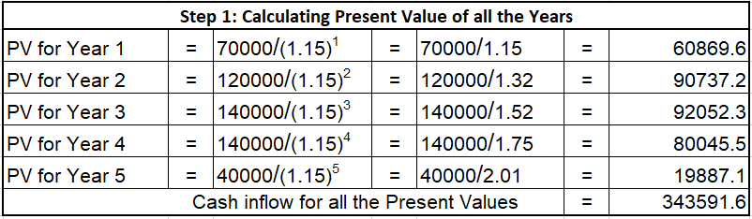
Example2: Calculating NPV
N.B: Though we have the same inflow & outflow of cash as in the previous example, the NPV value changed with the change in the Discount rate of interest.
Therefore, NPV is very much dependent on the Discount rate or in other words the opportunity cost of the capital value.
Cash Inflow of all Present Values is : $ 343591
Present value of Cash outflow is : $400,000
Net Present Value 🡺 PV of Cash inflows – PV of Cash Outflows 🡺 ($343591 – $400000) = $ -56408 dollars.
(negative 56408 dollars)
Since NPV is Negative, (i.e., - $56408, This project should be rejected)

Slide 23
Internal Rate of Return
Capital Budgeting
Net Present Value
Internal Rate of Return
Profitability Index
Payback Period

Slide 24
Internal Rate of Return (IRR)
IRR 🡪 % of Return on investment.
To put it simple: It is the percentage of Return of your investment.
How do we calculate IRR?
If you remembr from NPV example, we mentioned that the NPV is dependent on Discounted rate
If we increase the discount rate the NPV value decreases
We need to increase /decrease the discount rate to a level where NPV becomes zero
The discount rate at which NPV becomes zero is infact the Internal rate of return
In other words, IRR is the opportunity cost at which the NPV becomes Zero.

Slide 25
IRR
Let’s say at 8%, Discount rate, the NPV is 5000
And
Let’s say at 12%, Discount rate, the NPV is 0
Then 12% is the return, we are getting from the project
And
This 12% is called the IRR.
Discount Rate
Net Present Value

Slide 26
Internal Rate of Return (IRR)
Note:
For Constant rate of Cash inflow for every year, Internal Rate of Return can be calculated with the help of a formula.
For Uneven rate of Cash inflows for every year, IRR can be calculated by little trail & error adjustments.
Accept the project when Internal rate of return > Discount rate or Opportunity cost of capital.
Reject the project when Internal rate of return < Discount rate or Opportunity cost of capital.
May accept the project when Internal rate of return = Discount rate or Opportunity cost of capital.

Slide 27
Relationship between IRR, Discount rate and NPV
If IRR > Discount rate or Opportunity cost of capital 🡪 The NPV is always Positive.
If IRR < Discount rate or Opportunity cost of capital 🡪 The NPV is always Negative.
If IRR = Discount rate or Opportunity cost of capital 🡪 The NPV is Zero.
Note: As long as the NPV is Positive, the project is financially viable.
The moment that NPV becomes Negative, the Project is NOT financially viable.

Slide 28
Calculating Internal Rate of Return
Example:
The cost of a project is $1000. It has a time horizon of 5 years and the expected year wise incremental cash flows are:
Year 1 : $200
Year 2 : $300
Year 3 : $300
Year 4 : $400
Year 5 : $500
Compute IRR of the project. If opportunity cost of Capital is 12%, And tell us, should we accept the project?
Solution:
Step 1: Take “K” as 12% and calculate NPV value.
Step 2: If NPV < 0 then Project is NOT financially viable at 12% discount rate.
Step 3: If NPV > 0 then Project is financially viable at 12% however we need to know the actual IRR value, so we need to increase the K value to and calculate the NPV, continue it till you reach a point where the NPV becomes zero or close to zero.
Step 4: The “K” value at which NPV becomes Zero or “Near Zero” is the actual IRR (Internal Rate of Return)

Slide 29
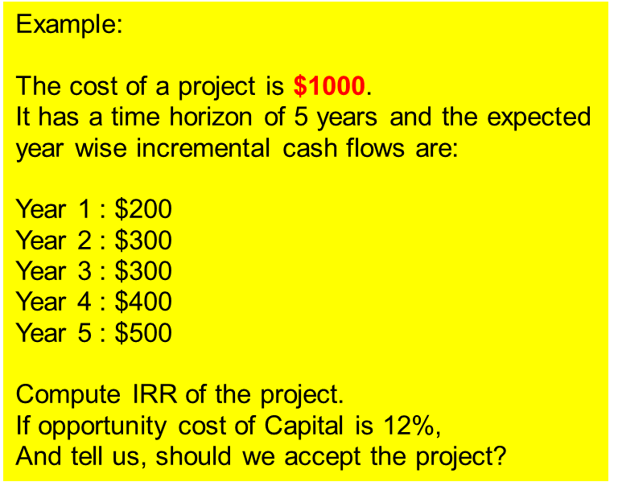
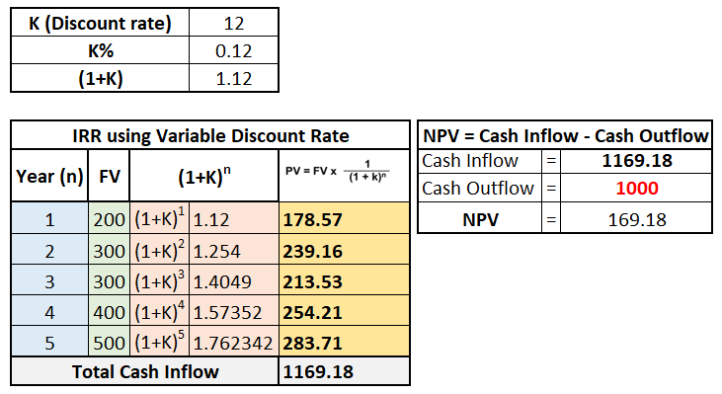

Calculating Internal Rate of Return
At Discount Rate of 12%, the NPV is 169 (positive)
At Discount Rate of 17.7%, the NPV is 0 (Zero), there fore the IRR is 17.7%
Since IRR > Discount rate, Project can be accepted

Slide 30
Profitability Index (PI)
Capital Budgeting
Criteria
If PI > = 1, Accept the Project.
If PI < 1, Reject the Project.
Net Present Value
Internal Rate of Return
For every dollar spent, how much are we getting back
Profitability Index
Payback Period

Slide 31
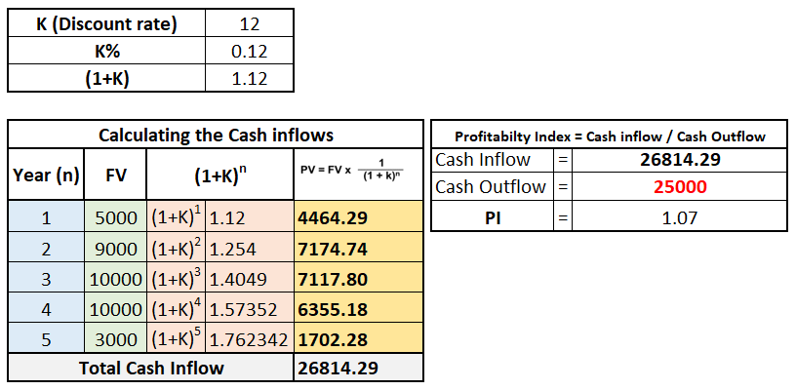

Profitability Index
A sum of $ 25,000 invested today in a project may give a series of cash inflows in future as described below:
$ 5000 in year 1
$ 9000 in year 2
$ 10,000 in each of year 3
$ 10,000 in each of year 4
$ 3000 in year 5
If the required rate of return is 12% pa,
what is the Profitability Index?
Profitability Index is 1.07 and since it is greater than 1, we can accept the project.

Slide 32
Payback Period
Capital Budgeting
Net Present Value
Internal Rate of Return
Profitability Index
Payback Period

Slide 33
Payback Period
The time it takes for the project to generate money to pay for itself.
Payback period is the number of years required to recover the cash outflow invested in the project.
The project would be accepted if its payback period is less than the maximum or standard payback period set by Industry, Senior Leadership.
In terms of Projects ranking, it gives highest ranking to the project with the shortest payback period.
Note: In general, the discounted cash flow is not considered for Pay back period. Some do, but most don’t!

Slide 34
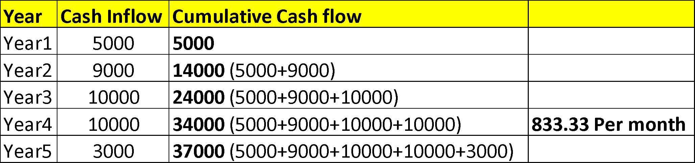
Payback Period
A sum of $25,000 invested today in an IT project, may give a series of cash inflows in future as described below.
$ 5,000 in year 1
$ 9,000 in year 2
$ 10,000 in each of year 3
$ 10,000 in each of year 4
$ 3,000 in year 5
What is the Payback Period (Non-discounted)?
Payback Period (Non-discounted) = In between 3 years 1 month and 3 years 2 months

Slide 35
Important: Few tips to Remember
Always choose projects with highest NPV.
If NPV is same for the given projects, choose the project with highest IRR.
If NPV, IRR remains the same for the given projects, choose the projects with early pay back period.
NPV = All Cash Inflows – Cash Outflows
PI = All Cash Inflows / Cash Outflows
IRR = Discount rate at which the NPV becomes zero, this tell us what is the percent of return for the project.
Payback period is a major consideration for every project, business or organization, it tells us how soon we can recover our investment and this investment can be utilized for other business needs/projects later on.

Slide 36
Quick Recap – Concepts Learned
Opportunity Cost / Discounted Cash flow
Time Value of Money
Calculating Future value
Calculating Present value
Based on the above concepts, we learnt how to solve
Capital Budgeting techniques.
Net Present Value - NPV
Internal Rate of Return - IRR
Profitability Index – PI
Payback Period - PBP

